Slide 1

Computing accumulated delays in real-time systems

Slide 2
Motivation
Model Checking has emerged as a powerful tool for automatic verification of FSM and it has been extended to real-time systems.
Given the description of a finite-state system together with its timing assumptions, there are algorithms that test whether the system satisfies a specification written in a real-time temporal logic.

Slide 3
Motivation
A time-bounded causality property can be specified using Real-time temporal logics.
For e.g.,
An alarm rings whenever the door of a refrigerator is open continuously for 30 seconds.
But a duration-bounded causality property is not expressible by Real-time temporal logics.
Thus, Standard real-time temporal logics have limited expressiveness. In particular, they do not allow us to constrain the accumulated satisfaction times of state predicates.
For e.g.,
A response is obtained whenever a ringer has been pressed, possibly intermittently, for a total duration of 20 seconds

Slide 4
The problem statement
To address the algorithmic verification problem for duration properties of real-time systems by using the formalism of timed automata for representing real-time systems.
More formally, Given a timed automaton with a duration measure, an initial and a final state, and an arithmetic constraint, the duration-bounded reachability problem asks if there is a run of the automaton from the initial state to the final state such that the duration of the run satisfies the constraint.
They show that the duration-bounded reachability problem is PSPACE-complete, and provide an optimal solution. The algorithm can be used to verify duration properties of real-time systems that are modeled as timed automata, such as the duration-bounded causality property.

Slide 5
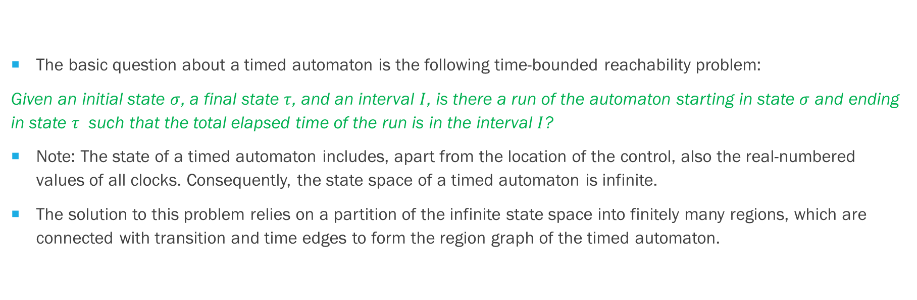
A brief overview
The basic question about a timed automaton is the following time-bounded reachability problem:
Given an initial state $σ$, a final state $τ$, and an interval $I$, is there a run of the automaton starting in state $σ$ and ending in state $τ$ such that the total elapsed time of the run is in the interval $I$?
Note: The state of a timed automaton includes, apart from the location of the control, also the real-numbered values of all clocks. Consequently, the state space of a timed automaton is infinite.
The solution to this problem relies on a partition of the infinite state space into finitely many regions, which are connected with transition and time edges to form the region graph of the timed automaton.

Slide 6
A brief overview
Unfortunately, the region graph is not enough for checking duration properties such as the duration-bounded causality property.
Why? Because the regions doesn’t capture the accumulated satisfaction time.
Hence a new technique is needed for analyzing duration properties!

Slide 7
A Brief Overview
To introduce the concept of durations in a timed automaton, they associate with every finite run a nonnegative real number, which is called the duration of the run.
The duration of a run is defined inductively using a duration measure, which is a function that maps the control locations to nonnegative integers:
i.e., the duration of an empty run is 0; and the duration measure of a location gives the rate at which the duration of a run increases while the automaton control resides in that location.
For example, a duration measure of 0 means that the duration of the run stays unchanged (i.e., the time spent in the location is not accumulated),
a duration measure of 1 means that the duration of the run increases at the rate of time (i.e., the time spent in the location is accumulated), and
a duration measure of 2 means that the duration of the run increases at twice the rate of time.

Slide 8
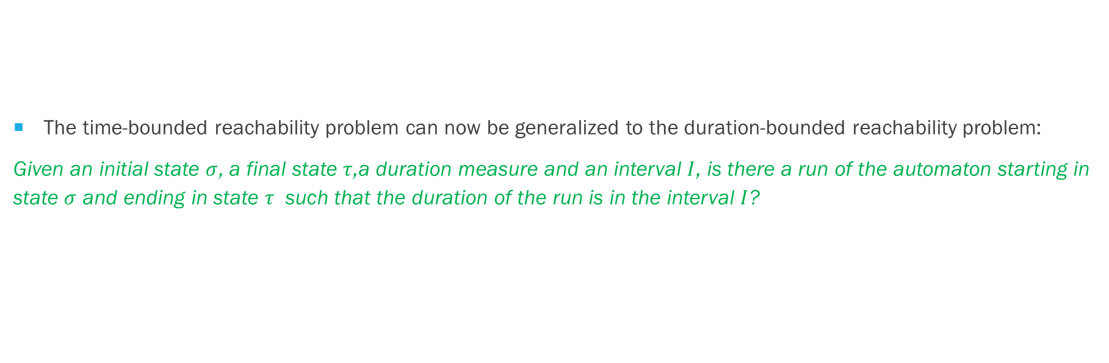
A Brief Overview
The time-bounded reachability problem can now be generalized to the duration-bounded reachability problem:
Given an initial state $σ$, a final state $τ$,a duration measure and an interval $I$, is there a run of the automaton starting in state $σ$ and ending in state $τ$ such that the duration of the run is in the interval $I$?

Slide 9
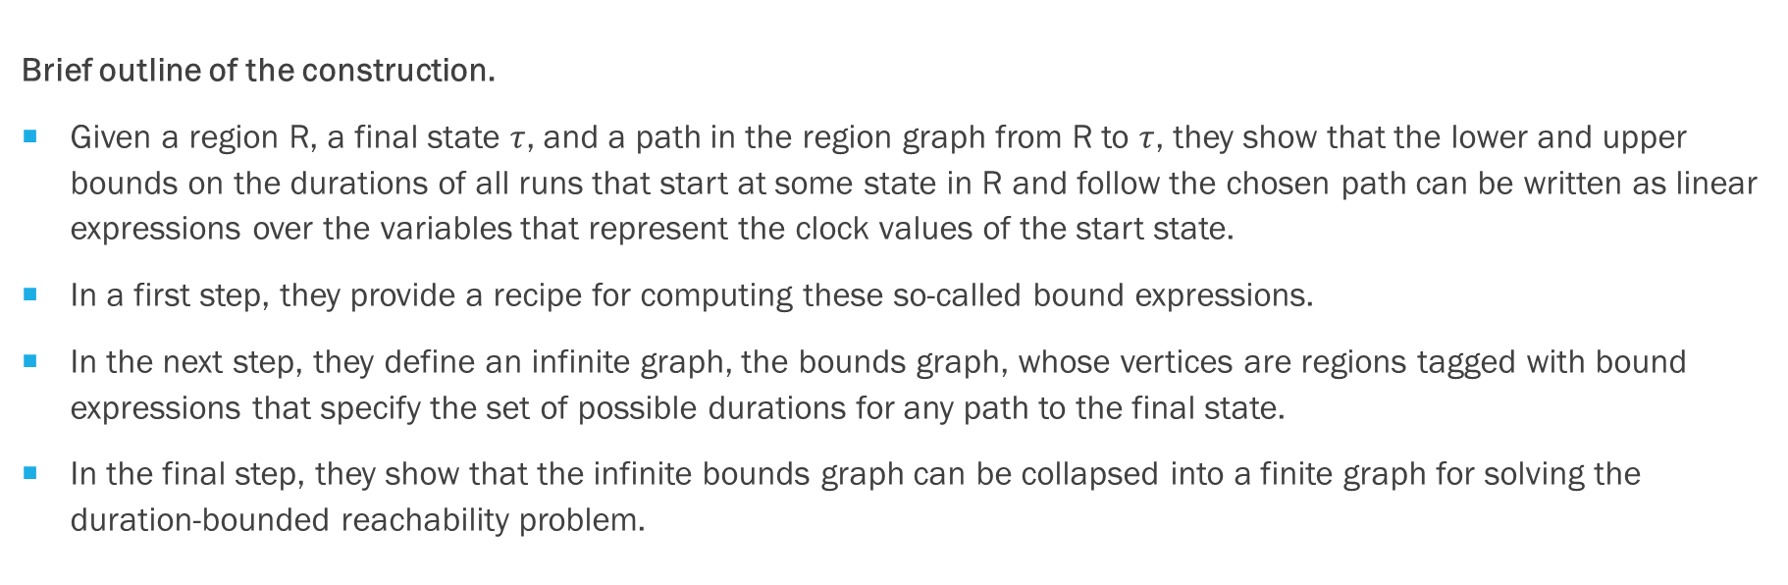
A Brief Overview
Brief outline of the construction.
Given a region R, a final state $τ$, and a path in the region graph from R to $τ$, they show that the lower and upper bounds on the durations of all runs that start at some state in R and follow the chosen path can be written as linear expressions over the variables that represent the clock values of the start state.
In a first step, they provide a recipe for computing these so-called bound expressions.
In the next step, they define an infinite graph, the bounds graph, whose vertices are regions tagged with bound expressions that specify the set of possible durations for any path to the final state.
In the final step, they show that the infinite bounds graph can be collapsed into a finite graph for solving the duration-bounded reachability problem.

Slide 10
THE DURATION BOUNDED REACHABILITY PROBLEM

Slide 11
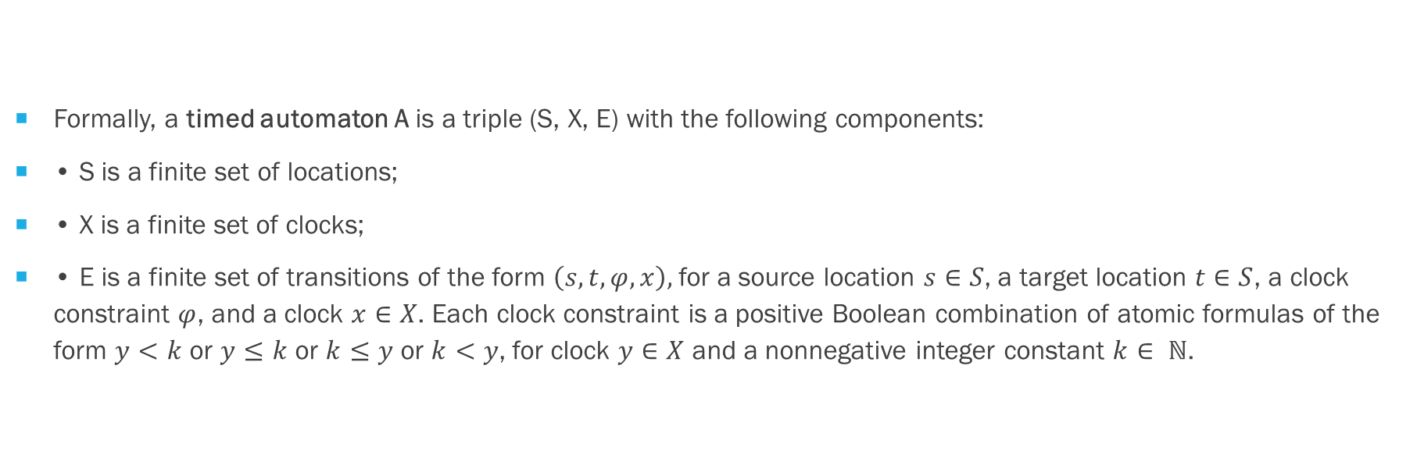
Some preliminary definitions
Formally, a timed automaton A is a triple (S, X, E) with the following components:
• S is a finite set of locations;
• X is a finite set of clocks;
• E is a finite set of transitions of the form $\left(s,t,φ,x\right),$for a source location $s∈S$, a target location $t∈S$, a clock constraint $φ$, and a clock $x∈X$. Each clock constraint is a positive Boolean combination of atomic formulas of the form $y<k$ or $y≤k$ or $k≤y$ or $k<y$, for clock $y∈X$ and a nonnegative integer constant $k∈ ℕ$.

Slide 12
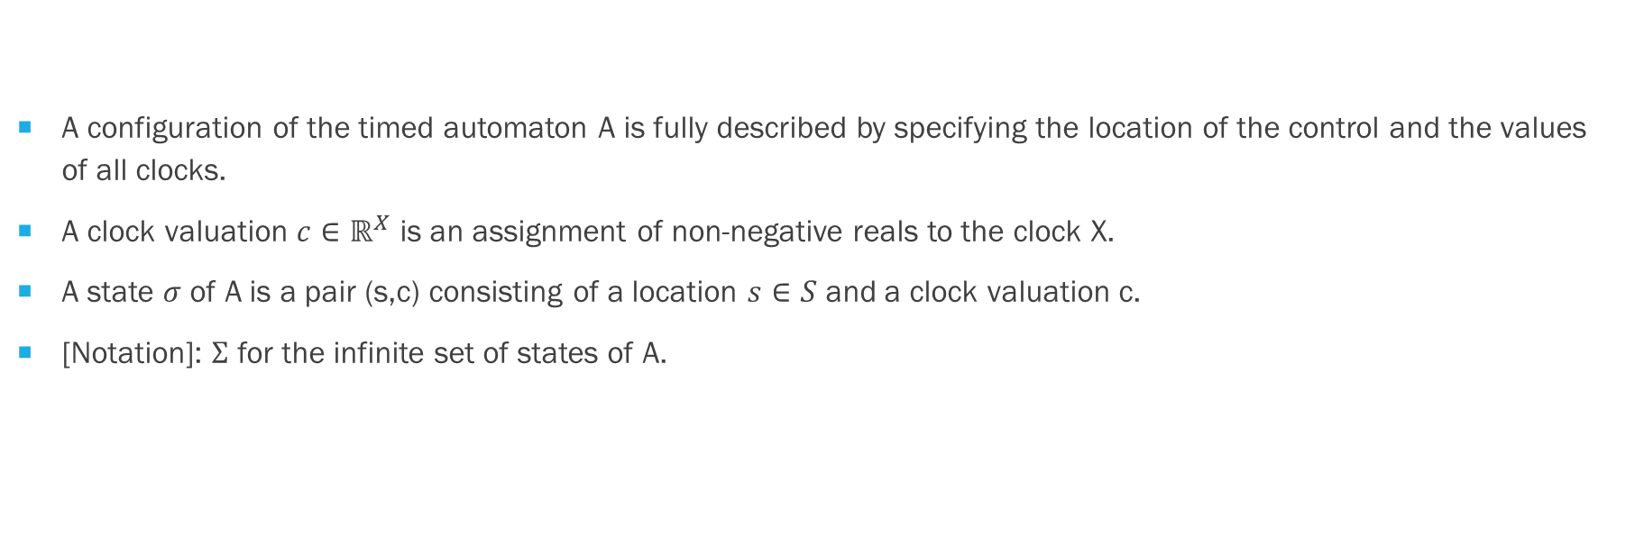
Some preliminary definitions
A configuration of the timed automaton A is fully described by specifying the location of the control and the values of all clocks.
A clock valuation $c∈ℝ^{X}$ is an assignment of non-negative reals to the clock X.
A state $σ$ of A is a pair (s,c) consisting of a location $s∈S$ and a clock valuation c.
[Notation]: $Σ$ for the infinite set of states of A.

Slide 13
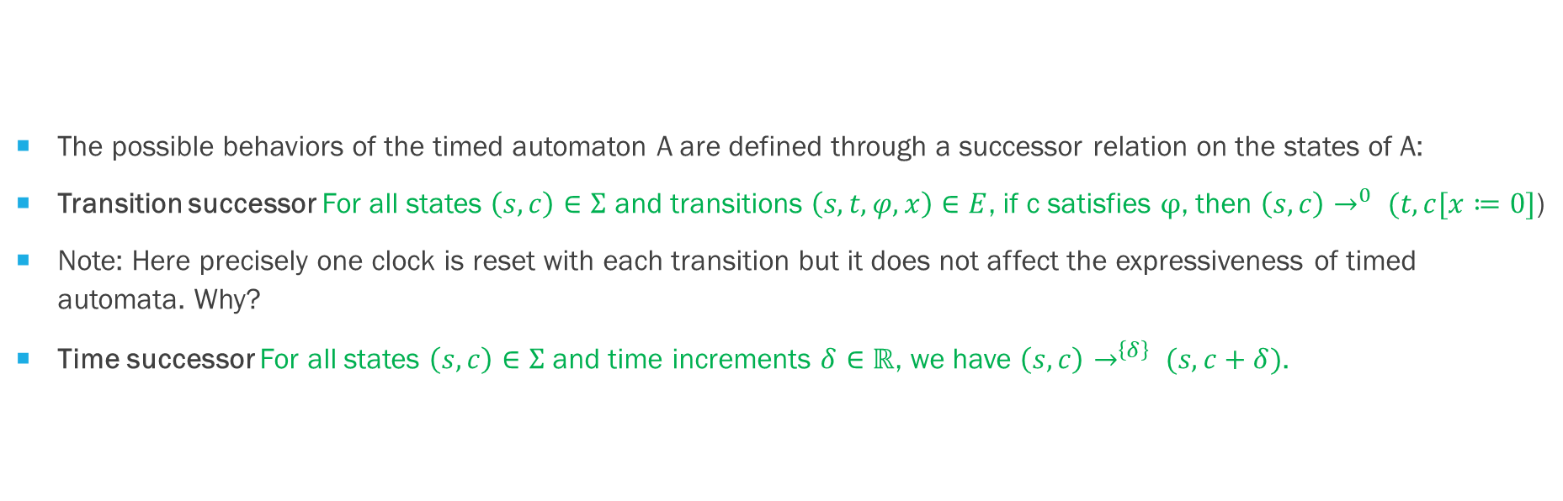
SOME preliminary definitions
The possible behaviors of the timed automaton A are defined through a successor relation on the states of A:
Transition successor For all states $\left(s,c\right)∈Σ$ and transitions $\left(s,t,φ,x\right)∈E$, if c satisfies $φ$, then $\left(s,c\right)→^{0} (t,c[x≔0]$)
Note: Here precisely one clock is reset with each transition but it does not affect the expressiveness of timed automata. Why?
Time successor For all states $\left(s,c\right)∈Σ$ and time increments $δ∈ℝ$, we have $\left(s,c\right)→^{\left\{δ\right\}} (s,c+δ)$.

Slide 14
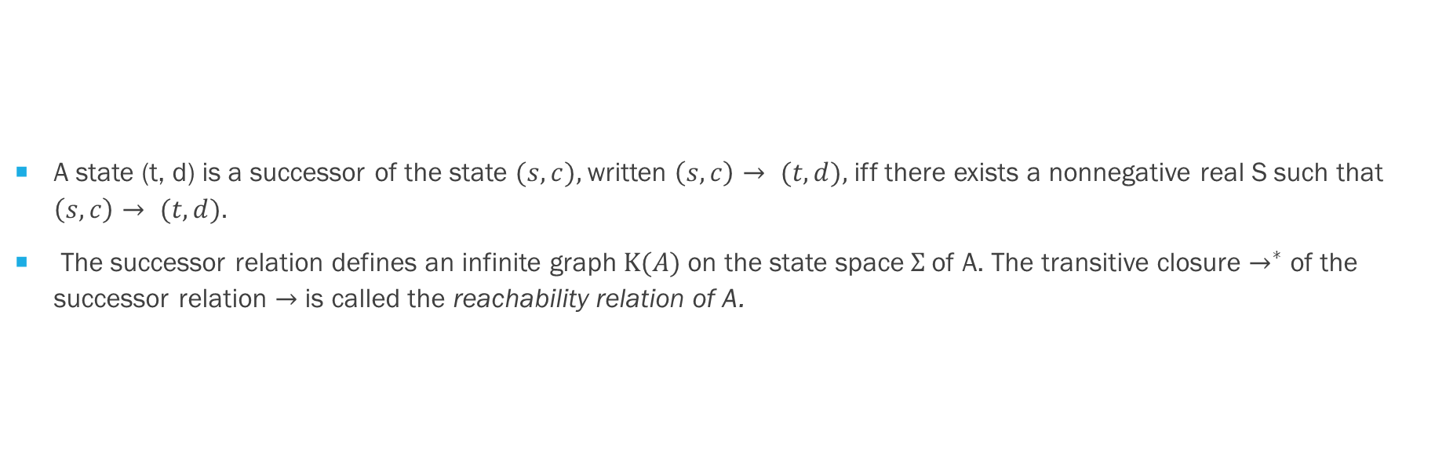
Some preliminary definitions
A state (t, d) is a successor of the state $(s,c),$written $\left(s,c\right)→ (t,d),$iff there exists a nonnegative real S such that $\left(s, c\right)→ (t,d).$
The successor relation defines an infinite graph $K(A)$on the state space$Σ$of A. The transitive closure $→^{∗}$ of the successor relation $→$ is called the reachability relation of A.

Slide 15
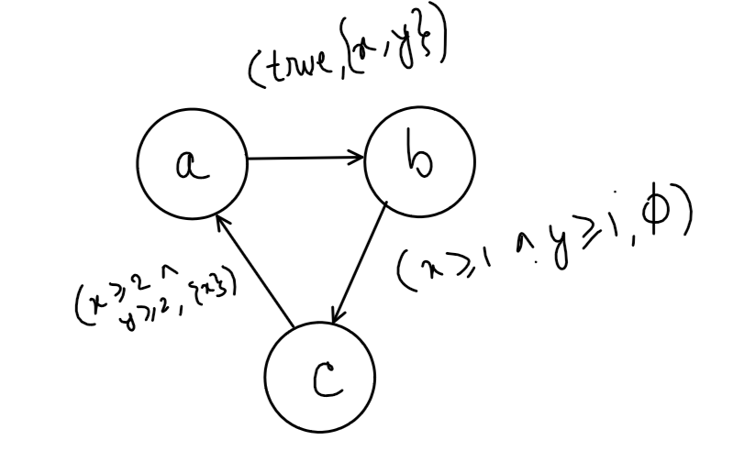
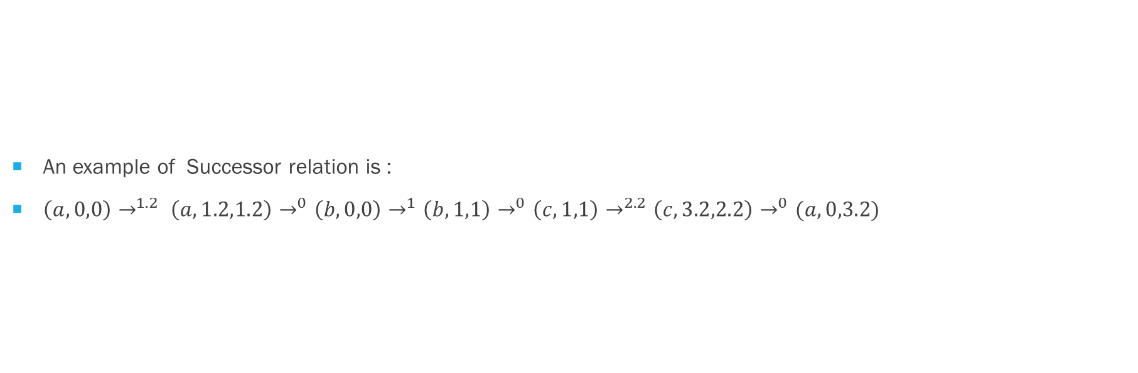
EXAMPLE of a timed run
An example of Successor relation is :
$\left(a,0,0\right)→^{1.2} \left(a,1.2,1.2\right)→^{0}\left(b,0,0\right)→^{1}\left(b,1,1\right)→^{0}\left(c,1,1\right)→^{2.2}\left(c,3.2,2.2\right)→^{0}(a,0,3.2)$

Slide 16
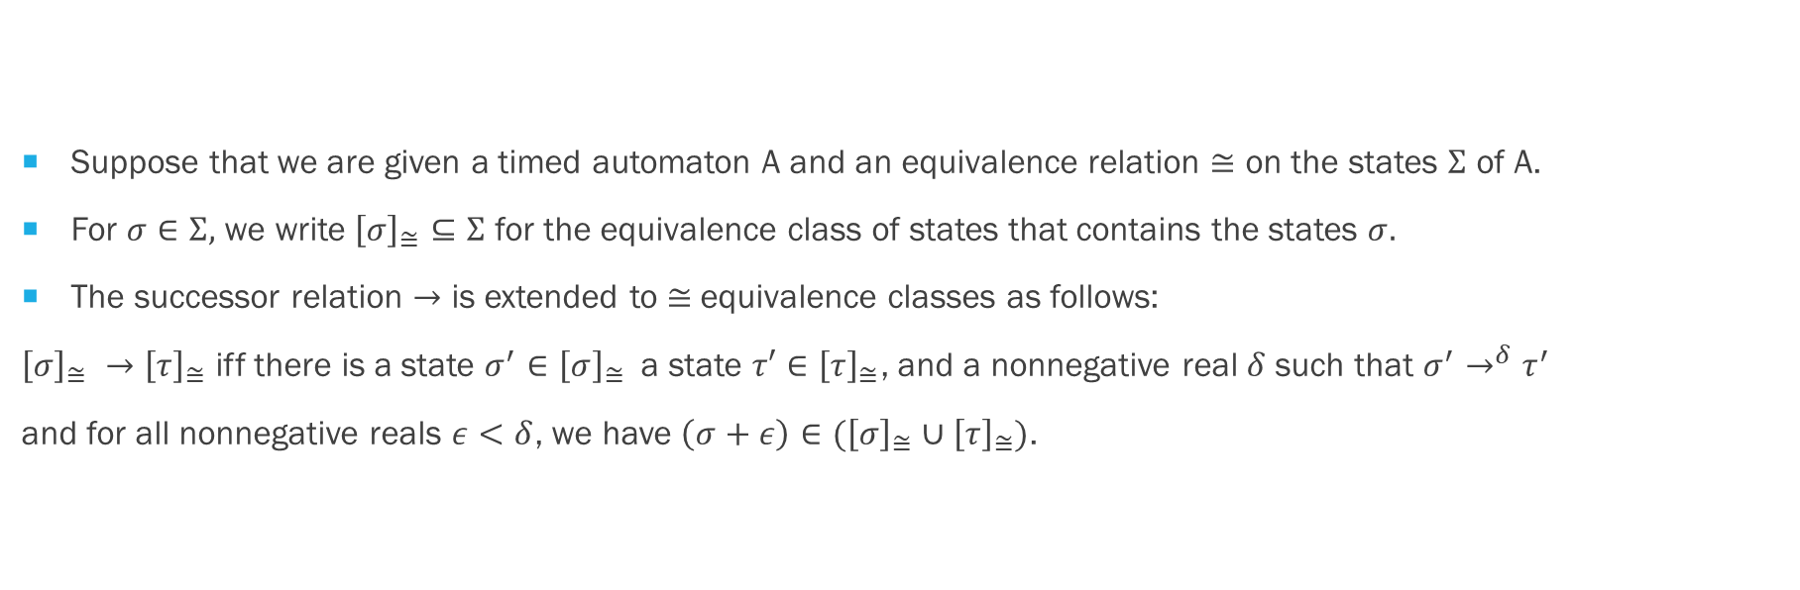
CLOCK REGIONS AND REGION GRAPH
Suppose that we are given a timed automaton A and an equivalence relation $≅$ on the states $Σ$ of A.
For $σ∈Σ,$ we write ${\left[σ\right]}_{≅}⊆Σ$ for the equivalence class of states that contains the states $σ.$
The successor relation $→$ is extended to $≅$equivalence classes as follows:
${\left[σ\right]}_{≅} →{\left[τ\right]}_{≅}$ iff there is a state $σ^{′}∈{\left[σ\right]}_{≅}$a state ${τ′∈\left[τ\right]}_{≅}$, and a nonnegative real $δ$ such that $σ^{′}→^{δ}τ^{′}$
and for all nonnegative reals $ε<δ$, we have $\left(σ+ε\right)∈({\left[σ\right]}_{≅}∪{\left[τ\right]}_{≅})$.

Slide 17
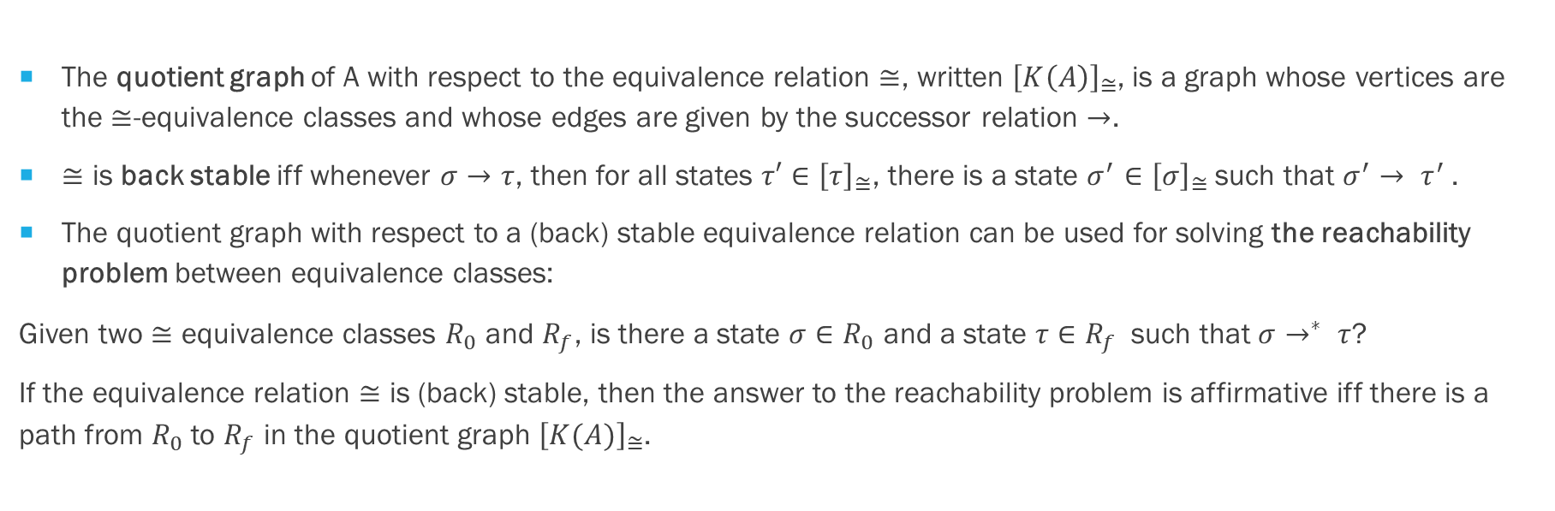
CLOCK REGIONS AND REGION GRAPH
The quotient graph of A with respect to the equivalence relation $≅$, written ${\left[K\left(A\right)\right]}_{≅}$, is a graph whose vertices are the $≅$-equivalence classes and whose edges are given by the successor relation $→$.
$≅$ is back stable iff whenever $σ→τ$, then for all states ${τ′∈\left[τ\right]}_{≅}$, there is a state $σ^{′}∈{\left[σ\right]}_{≅}$such that $σ^{′}→ τ^{′}$.
The quotient graph with respect to a (back) stable equivalence relation can be used for solving the reachability problem between equivalence classes:
Given two $≅$ equivalence classes $R_{0}$ and $R_{f}$, is there a state $σ∈R_{0}$ and a state $τ∈R_{f}$such that $σ→^{∗} τ$?
If the equivalence relation $≅$ is (back) stable, then the answer to the reachability problem is affirmative iff there is a path from $R_{0}$ to $R_{f}$ in the quotient graph ${\left[K(A)\right]}_{≅}$.

Slide 18
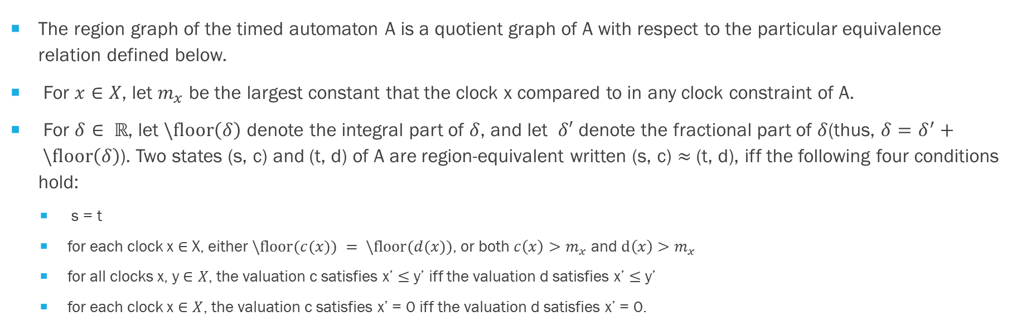
REGION GRAPH
The region graph of the timed automaton A is a quotient graph of A with respect to the particular equivalence relation defined below.
For $x∈X$, let $m_{x}$ be the largest constant that the clock x compared to in any clock constraint of A.
For $δ∈ ℝ$, let $\backslash floor\left(δ\right)$ denote the integral part of $δ$, and let $δ′$ denote the fractional part of $δ$(thus, $δ=δ^{′}+ \backslash floor\left(δ\right)$). Two states (s, c) and (t, d) of A are region-equivalent written (s, c) $≈$ (t, d), iff the following four conditions hold:
s = t
for each clock x $∈$ X, either $\backslash floor(c(x)) = \backslash floor(d(x))$, or both $c\left(x\right)>m_{x}$ and $d\left(x\right)>m_{x}$
for all clocks x, y $∈X$, the valuation c satisfies x’ $≤$ y’ iff the valuation d satisfies x’ $≤$ y’
for each clock x $∈X$, the valuation c satisfies x’ = 0 iff the valuation d satisfies x’ = 0.

Slide 19
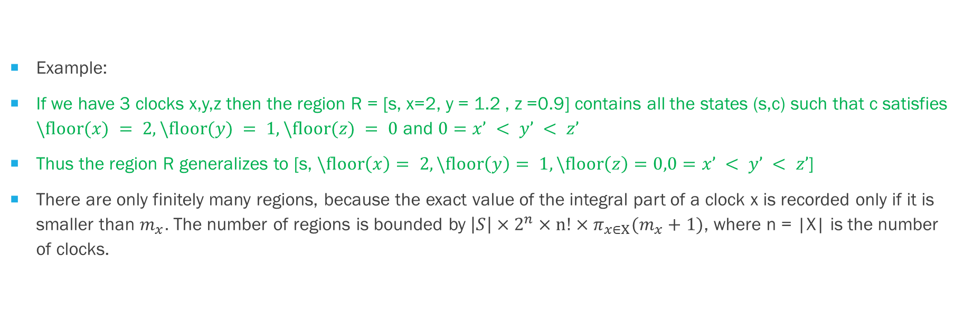
REGION GRAPH
Example:
If we have 3 clocks x,y,z then the region R = [s, x=2, y = 1.2 , z =0.9] contains all the states (s,c) such that c satisfies $\backslash floor(x) = 2, \backslash floor(y) = 1, \backslash floor(z) = 0$ and $0=x’ < y’ < z’$
Thus the region R generalizes to [s, $\backslash floor\left(x\right)= 2, \backslash floor\left(y\right)= 1, \backslash floor\left(z\right)=0,0=x’ < y’ < z’$]
There are only finitely many regions, because the exact value of the integral part of a clock x is recorded only if it is smaller than $m_{x}.$ The number of regions is bounded by $\left|S\right|×2^{n}×n!×π_{x∈X}(m_{x}+1)$, where n = |X| is the number of clocks.

Slide 20
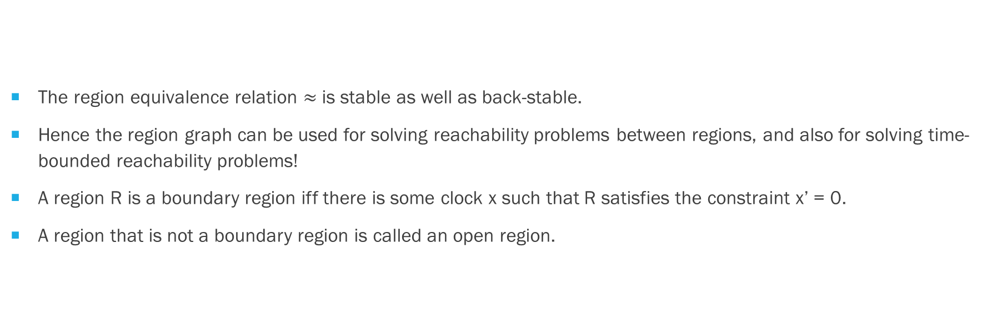
REGION GRAPH
The region equivalence relation $≈$is stable as well as back-stable.
Hence the region graph can be used for solving reachability problems between regions, and also for solving time-bounded reachability problems!
A region R is a boundary region iff there is some clock x such that R satisfies the constraint x’ = 0.
A region that is not a boundary region is called an open region.

Slide 21
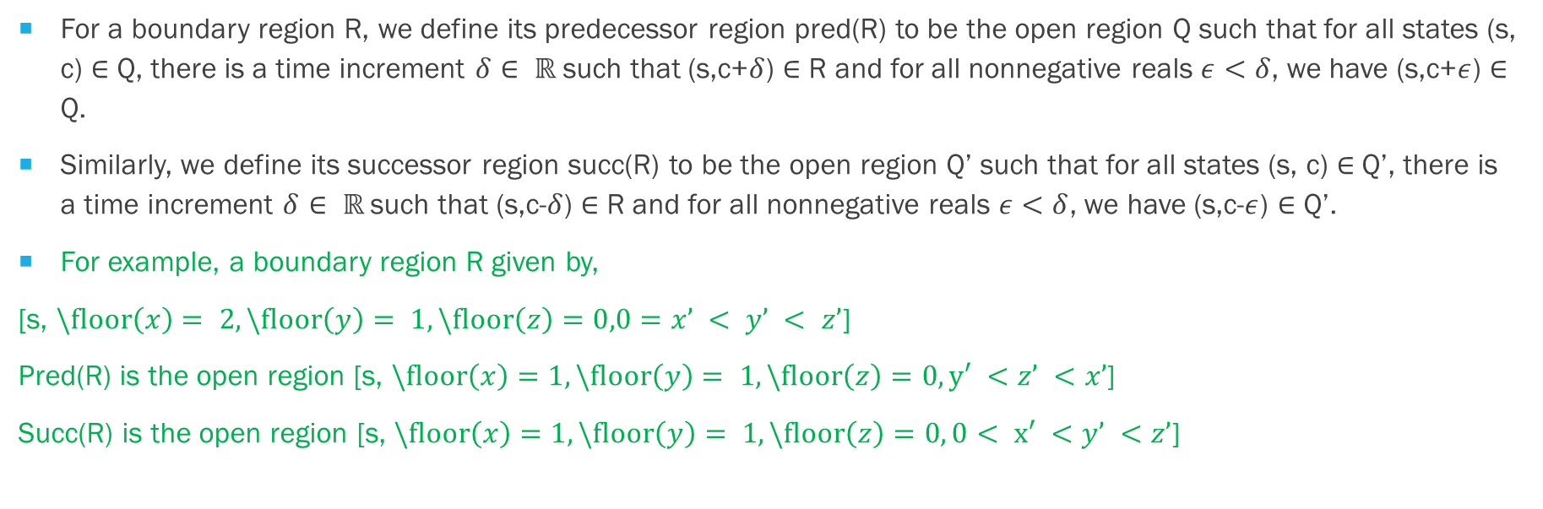
REGION GRAPH
For a boundary region R, we define its predecessor region pred(R) to be the open region Q such that for all states (s, c) $∈$ Q, there is a time increment $δ∈ ℝ$such that (s,c+$δ$) $∈$ R and for all nonnegative reals $ε<δ$, we have (s,c+$ε$) $∈$ Q.
Similarly, we define its successor region succ(R) to be the open region Q’ such that for all states (s, c) $∈$ Q’, there is a time increment $δ∈ ℝ$such that (s,c-$δ$) $∈$ R and for all nonnegative reals $ε<δ$, we have (s,c-$ε$) $∈$ Q’.
For example, a boundary region R given by,
[s, $\backslash floor\left(x\right)= 2, \backslash floor\left(y\right)= 1, \backslash floor\left(z\right)=0,0=x’ < y’ < z’$]
Pred(R) is the open region [s, $\backslash floor\left(x\right)=1, \backslash floor\left(y\right)= 1, \backslash floor\left(z\right)=0, y′ <z’ <x’$]
Succ(R) is the open region [s, $\backslash floor\left(x\right)=1, \backslash floor\left(y\right)= 1, \backslash floor\left(z\right)=0, 0< x′ <y’ <z’$]

Slide 22
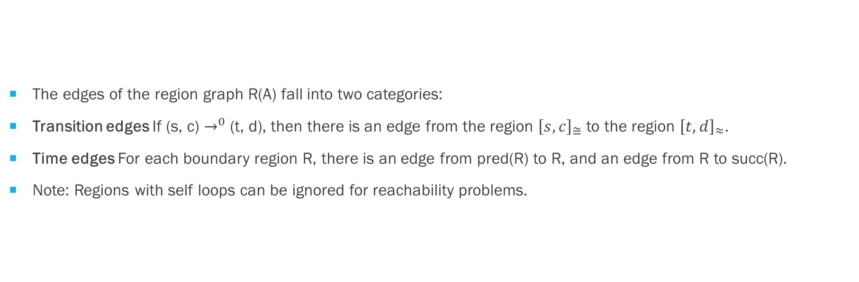
REGION GRAPH
The edges of the region graph R(A) fall into two categories:
Transition edges If (s, c) $→^{0}$ (t, d), then there is an edge from the region ${\left[s, c\right]}_{≅}$ to the region ${\left[t, d\right]}_{≈}$.
Time edges For each boundary region R, there is an edge from pred(R) to R, and an edge from R to succ(R).
Note: Regions with self loops can be ignored for reachability problems.

Slide 23
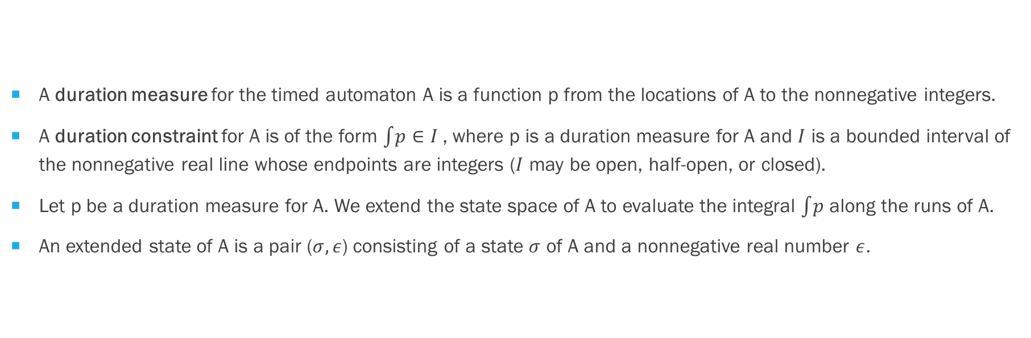
Duration measures and duration bounded reachability
A duration measure for the timed automaton A is a function p from the locations of A to the nonnegative integers.
A duration constraint for A is of the form $\int{p}∈I$, where p is a duration measure for A and $I$ is a bounded interval of the nonnegative real line whose endpoints are integers ($I$ may be open, half-open, or closed).
Let p be a duration measure for A. We extend the state space of A to evaluate the integral $\int{p}$ along the runs of A.
An extended state of A is a pair ($σ,ε$) consisting of a state $σ$ of A and a nonnegative real number $ε$.

Slide 24
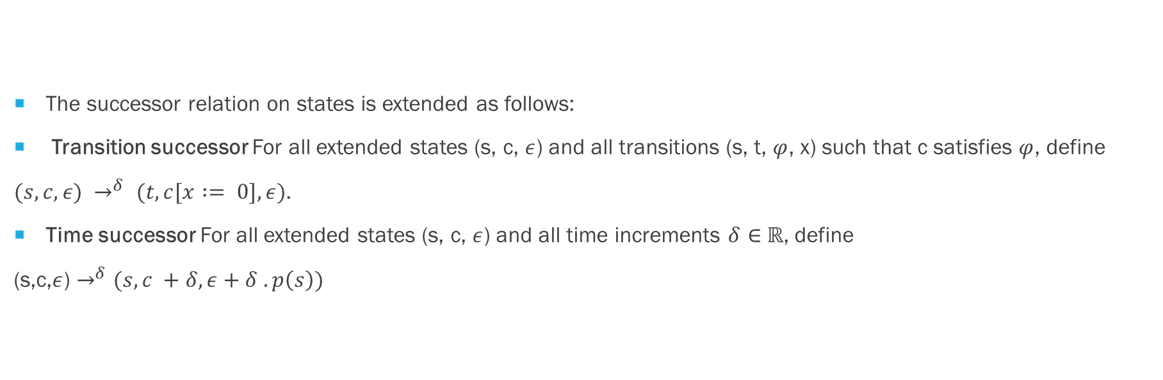
Duration measures and duration bounded reachability
The successor relation on states is extended as follows:
Transition successor For all extended states (s, c, $ε$) and all transitions (s, t, $φ$, x) such that c satisfies $φ$, define
$(s, c, ε) →^{δ} (t, c[x := 0],ε)$.
Time successor For all extended states (s, c, $ε$) and all time increments $δ∈$ $ℝ$, define
(s,c,$ε$) $→^{δ}$ $(s, c +δ, ε+δ .p\left(s\right))$

Slide 25

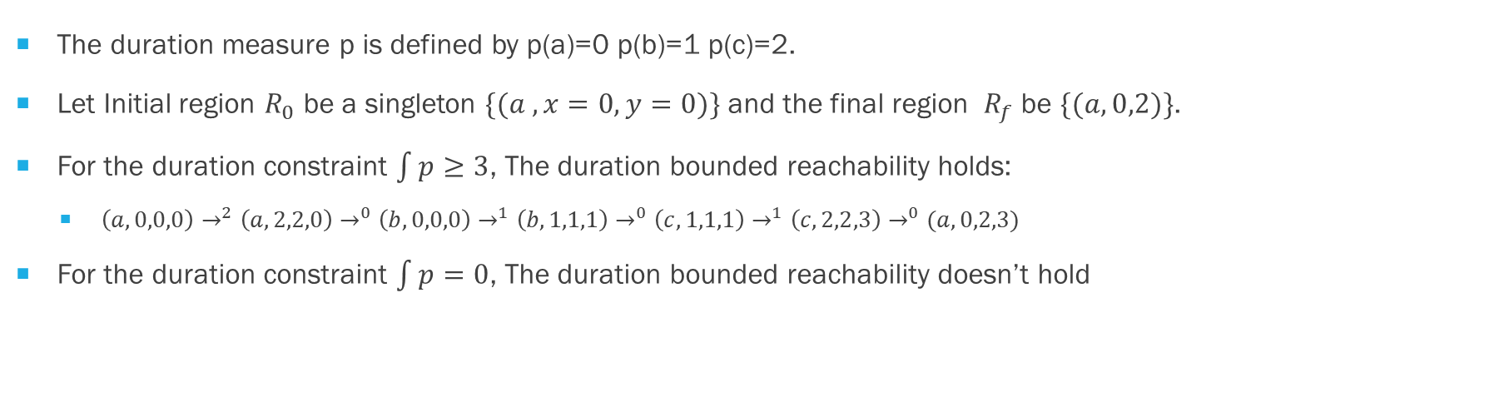
Duration measures and duration bounded reachability
The duration measure p is defined by p(a)=0 p(b)=1 p(c)=2.
Let Initial region $R_{0}$ be a singleton $\{(a ,x=0,y=0)\}$ and the final region $R_{f}$be $\{(a,0,2)\}$.
For the duration constraint $\int{p≥3}$, The duration bounded reachability holds:
$\left(a,0,0,0\right)→^{2}\left(a,2,2,0\right)→^{0}\left(b,0,0,0\right)→^{1}\left(b,1,1,1\right)→^{0}\left(c,1,1,1\right)→^{1}\left(c,2,2,3\right)→^{0}(a,0,2,3)$
For the duration constraint $\int{p=0}$, The duration bounded reachability doesn’t hold

Slide 26
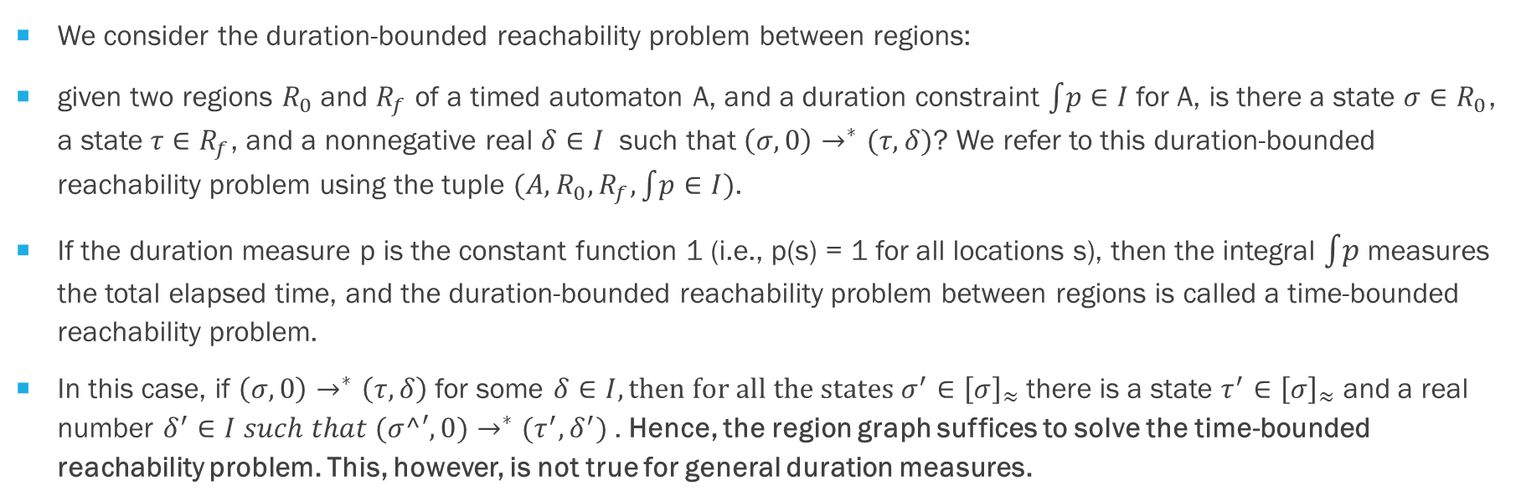
Duration measures and duration bounded reachability
We consider the duration-bounded reachability problem between regions:
given two regions $R_{0}$ and $R_{f}$ of a timed automaton A, and a duration constraint $\int{p}$ $∈I$ for A, is there a state $σ∈R_{0}$, a state $τ∈R_{f}$, and a nonnegative real $δ∈I$ such that $\left(σ,0\right)→^{∗}(τ,δ)$? We refer to this duration-bounded reachability problem using the tuple $(A,R_{0},R_{f},\int{p}∈I)$.
If the duration measure p is the constant function 1 (i.e., p(s) = 1 for all locations s), then the integral $\int{p}$ measures the total elapsed time, and the duration-bounded reachability problem between regions is called a time-bounded reachability problem.
In this case, if $\left(σ,0\right)→^{∗}\left(τ,δ\right)$ for some $δ∈I, then for all the states σ^{′}∈{\left[σ\right]}_{≈}$there is a state $τ^{′}∈{\left[σ\right]}_{≈}$ and a real number $δ^{′}∈I such that (σ^′,0)→^{∗}(τ^{′},δ^{′})$. Hence, the region graph suffices to solve the time-bounded reachability problem. This, however, is not true for general duration measures.

Slide 27
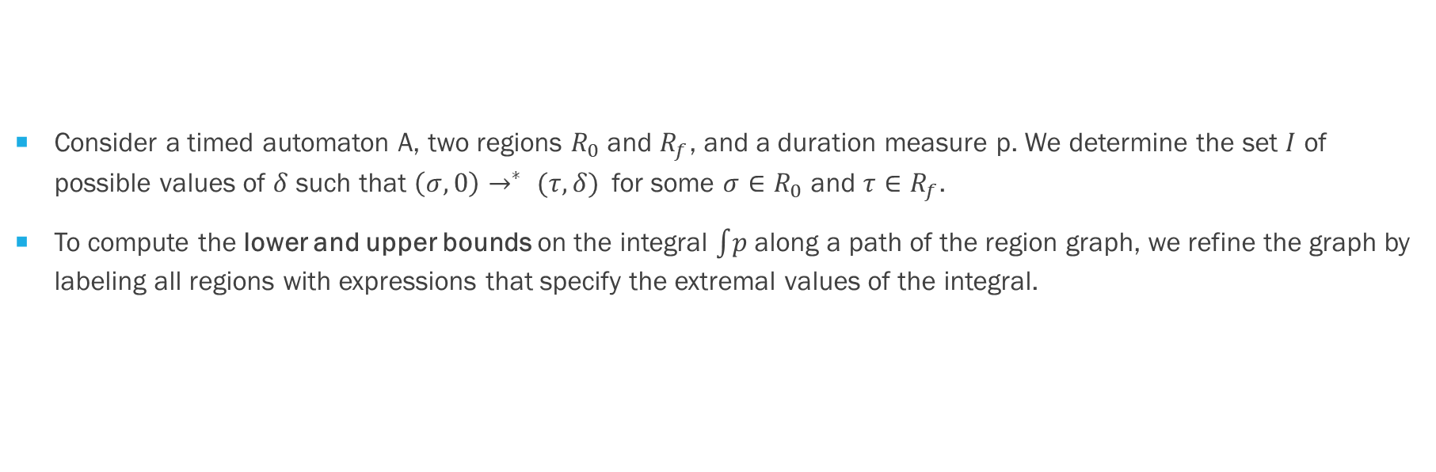
BOUNDED-labeled regions and the bounds graph
Consider a timed automaton A, two regions $R_{0}$ and $R_{f}$, and a duration measure p. We determine the set $I$ of possible values of $δ$ such that $\left(σ,0\right)→^{∗} (τ,δ)$ for some $σ∈R_{0}$ and $τ∈R_{f}$.
To compute the lower and upper bounds on the integral $\int{p}$ along a path of the region graph, we refine the graph by labeling all regions with expressions that specify the extremal values of the integral.

Slide 28
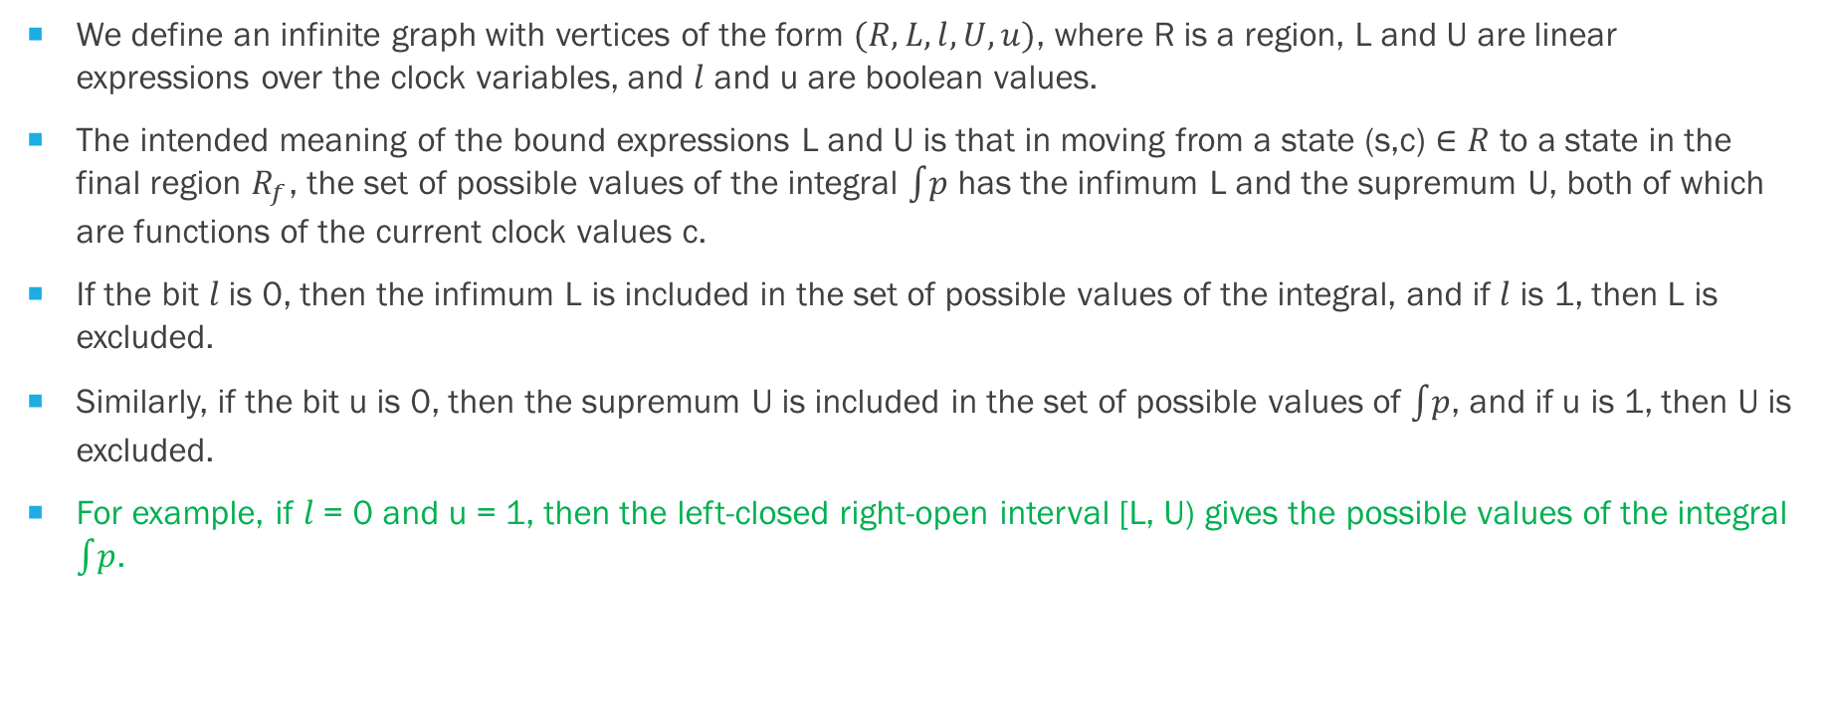
BOUNDED-labeled regions and the bounds graph
We define an infinite graph with vertices of the form $(R,L,l,U,u)$, where R is a region, L and U are linear expressions over the clock variables, and $l$ and u are boolean values.
The intended meaning of the bound expressions L and U is that in moving from a state (s,c) $∈R$ to a state in the final region $R_{f}$, the set of possible values of the integral $\int{p}$ has the infimum L and the supremum U, both of which are functions of the current clock values c.
If the bit $l$ is 0, then the infimum L is included in the set of possible values of the integral, and if $l$ is 1, then L is excluded.
Similarly, if the bit u is 0, then the supremum U is included in the set of possible values of $\int{p}$, and if u is 1, then U is excluded.
For example, if $l$ = 0 and u = 1, then the left-closed right-open interval [L, U) gives the possible values of the integral $\int{p}$.

Slide 29
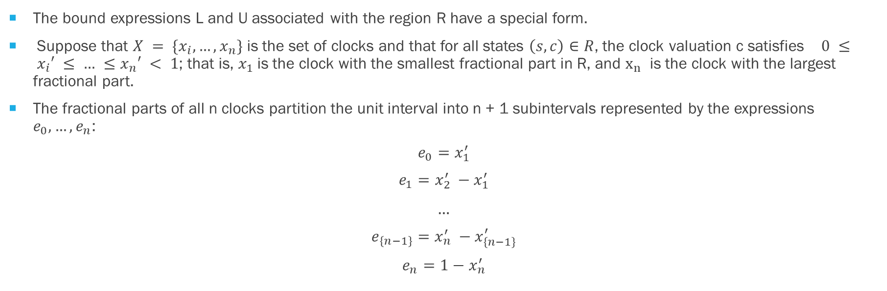
BOUND Expression
The bound expressions L and U associated with the region R have a special form.
Suppose that $X = \{x_{i},…, x_{n}\}$ is the set of clocks and that for all states $\left(s,c\right)∈R$, the clock valuation c satisfies $0 ≤ x_{i}′ ≤ … ≤x_{n}′ < 1$; that is, $x_{1}$is the clock with the smallest fractional part in R, and $x_{n}$ is the clock with the largest fractional part.
The fractional parts of all n clocks partition the unit interval into n + 1 subintervals represented by the expressions $e_{0},…, e_{n}$:
$$e_{0}=x_{1}^{′}$$
$$e_{1}=x_{2}^{′} −x_{1}^{′}$$
…
$$e_{\left\{n−1\right\}}=x_{n}^{′} −x_{\left\{n−1\right\}}^{′}$$
$$e_{n}=1−x_{n}^{′}$$

Slide 30
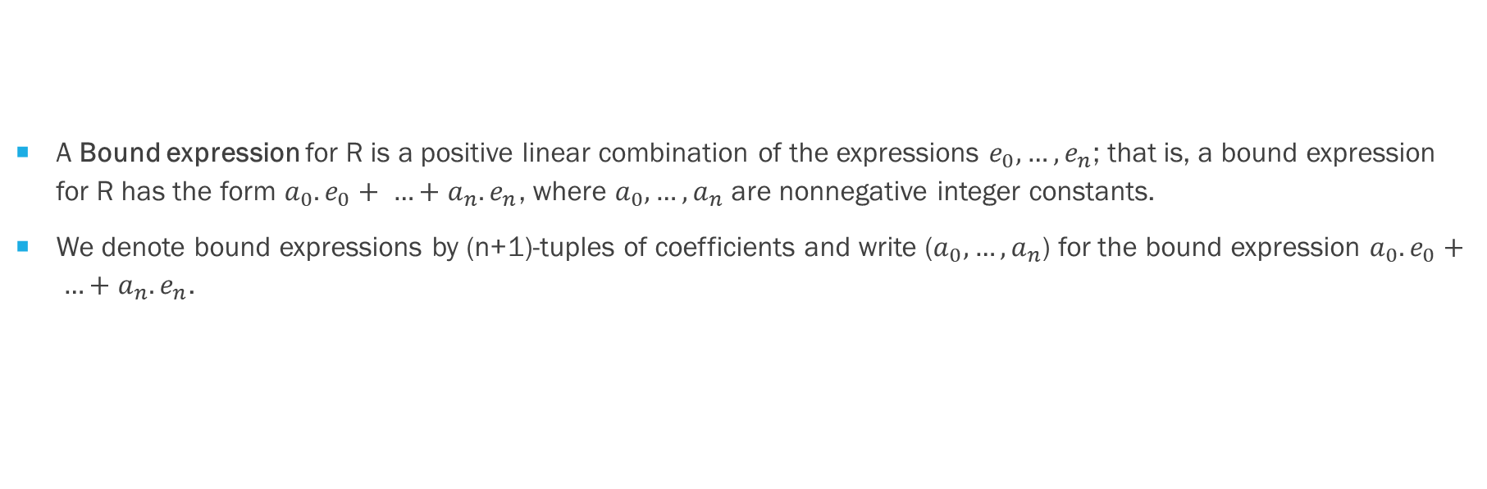
BOUND Expression
A Bound expression for R is a positive linear combination of the expressions $e_{0},…,e_{n}$; that is, a bound expression for R has the form $a_{0}.e_{0}+ …+a_{n}.e_{n}$, where $a_{0},…, a_{n}$ are nonnegative integer constants.
We denote bound expressions by (n+1)-tuples of coefficients and write ($a_{0},…,a_{n}$) for the bound expression $a_{0}.e_{0}+ …+a_{n}.e_{n}$.

Slide 31
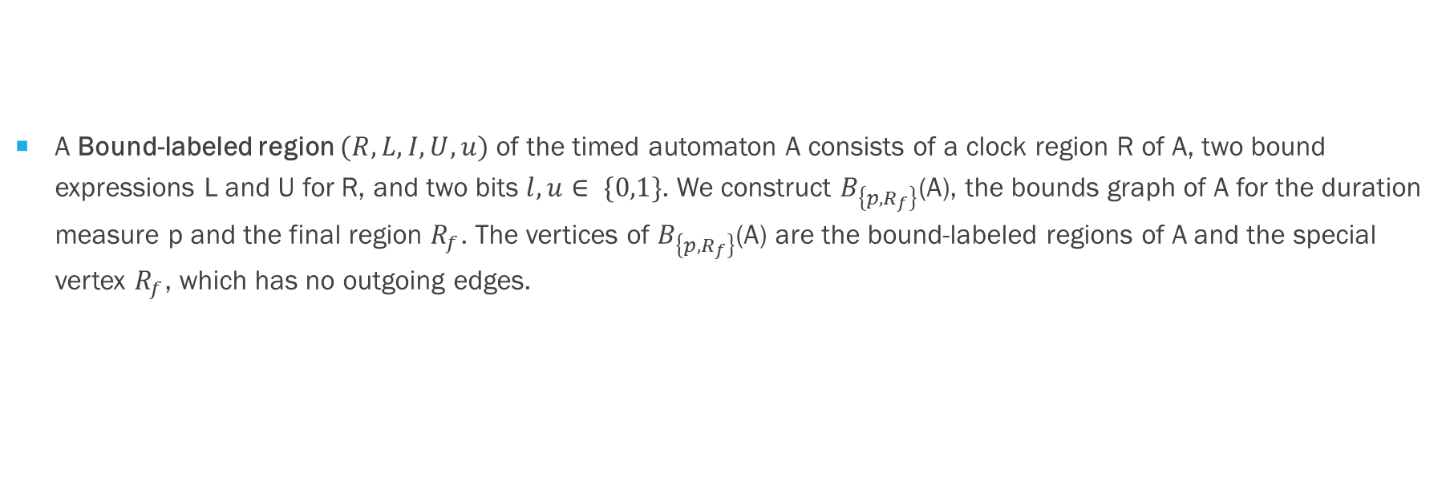
BOUND-labeled regions
A Bound-labeled region $(R, L,I,U, u)$ of the timed automaton A consists of a clock region R of A, two bound expressions L and U for R, and two bits $l,u∈ \{0,1\}$. We construct $B_{\left\{p,R_{f}\right\}}$(A), the bounds graph of A for the duration measure p and the final region $R_{f}$. The vertices of $B_{\left\{p,R_{f}\right\}}$(A) are the bound-labeled regions of A and the special vertex $R_{f}$, which has no outgoing edges.

Slide 32
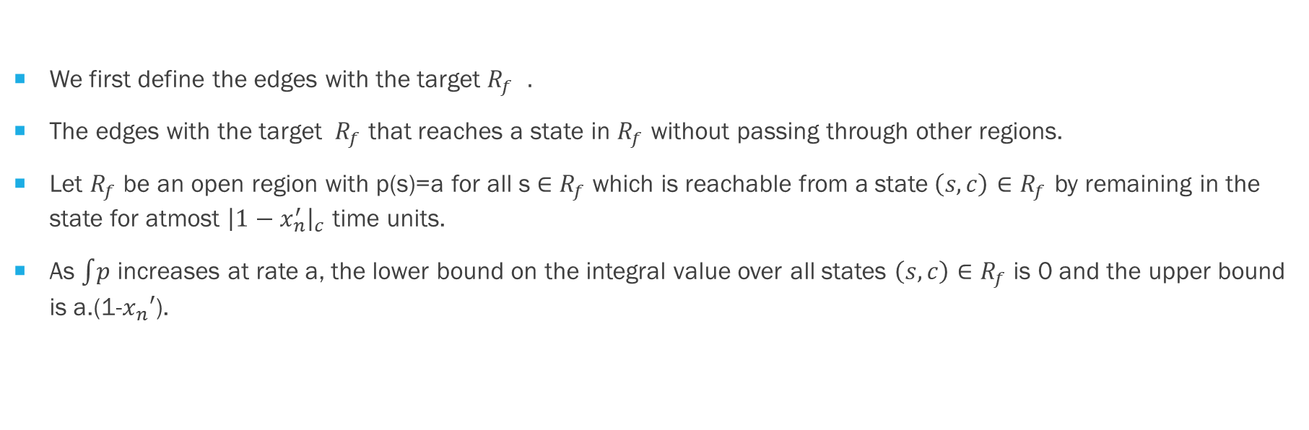
BOUND-labeled regions
We first define the edges with the target $R_{f }.$
The edges with the target $R_{f}$ that reaches a state in $R_{f}$ without passing through other regions.
Let $R_{f}$ be an open region with p(s)=a for all s $∈$ $R_{f}$which is reachable from a state$\left(s,c\right)∈R_{f}$ by remaining in the state for atmost ${\left|1−x_{n}^{′}\right|}_{c}$ time units.
As $\int{p}$ increases at rate a, the lower bound on the integral value over all states $\left(s,c\right)∈R_{f}$ is 0 and the upper bound is a.(1-$x_{n}′$).

Slide 33
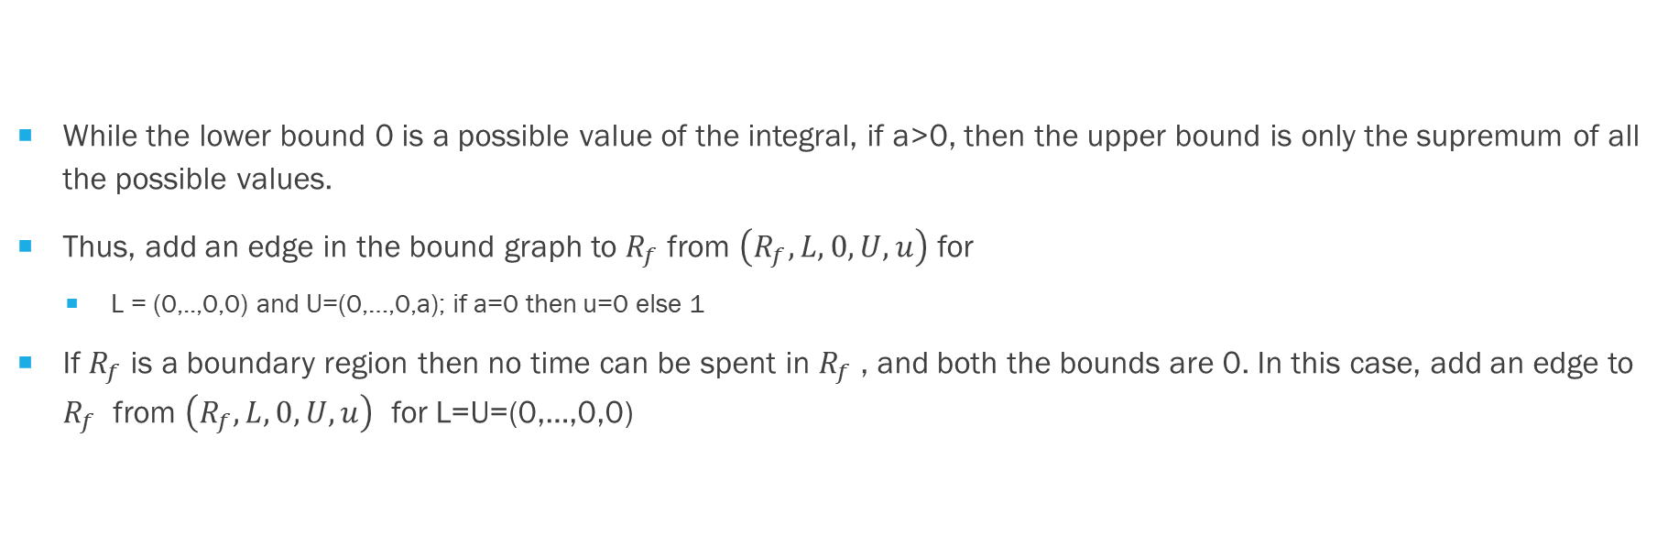
BOUND-labeled regions
While the lower bound 0 is a possible value of the integral, if a>0, then the upper bound is only the supremum of all the possible values.
Thus, add an edge in the bound graph to $R_{f}$from $\left(R_{f},L,0,U,u\right)$ for
L = (0,..,0,0) and U=(0,…,0,a); if a=0 then u=0 else 1
If $R_{f}$is a boundary region then no time can be spent in $R_{f}$, and both the bounds are 0. In this case, add an edge to $R_{f}$ from $\left(R_{f},L,0,U,u\right)$ for L=U=(0,…,0,0)

Slide 34
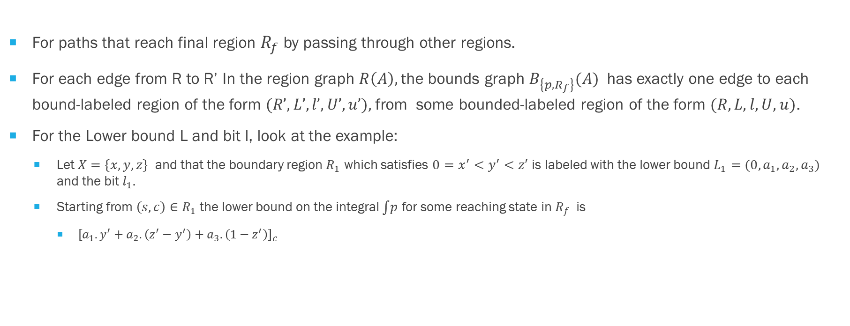
BOUND-labeled regions
For paths that reach final region $R_{f}$ by passing through other regions.
For each edge from R to R’ In the region graph $R\left(A\right), t$he bounds graph $B_{\left\{p,R_{f}\right\}}(A)$ has exactly one edge to each bound-labeled region of the form $(R’,L’,l’,U’,u’),$from some bounded-labeled region of the form $(R,L,l,U,u)$.
For the Lower bound L and bit l, look at the example:
Let $X=\{x,y,z\}$ and that the boundary region $R_{1}$ which satisfies $0=x^{′}<y^{′}<z′$ is labeled with the lower bound $L_{1}=(0,a_{1},a_{2},a_{3})$ and the bit $l_{1}.$
Starting from $\left(s,c\right)∈R_{1}$ the lower bound on the integral $\int{p}$ for some reaching state in $R_{f}$ is
${\left[a_{1}.y^{′}+a_{2}.\left(z^{′}−y^{′}\right)+a_{3}.\left(1−z^{′}\right)\right]}_{c}$

Slide 35
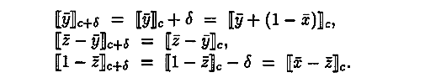

BOUND-labeled regions
Look at the open predecessor region $R_{2} of R_{1}$that satisfies $0<y^{′}<z^{′}<x^{′}.$
Duration measure P(s)=a for all $s∈R_{2}$
There is a time edge from $R_{2} to R_{1}$ in the graph.
To compute the lower bound label for $L_{2} for R_{2}$ from the lower bound label $L_{1} of R_{1}.$
Starting from (s,c) $∈R_{2},$ the state (s,c+$δ)$ $∈R_{1}$ is reached after the time $δ={\left[1−x^{′}\right]}_{c}$ and

Slide 36
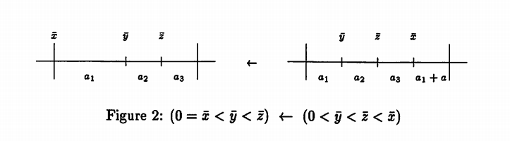
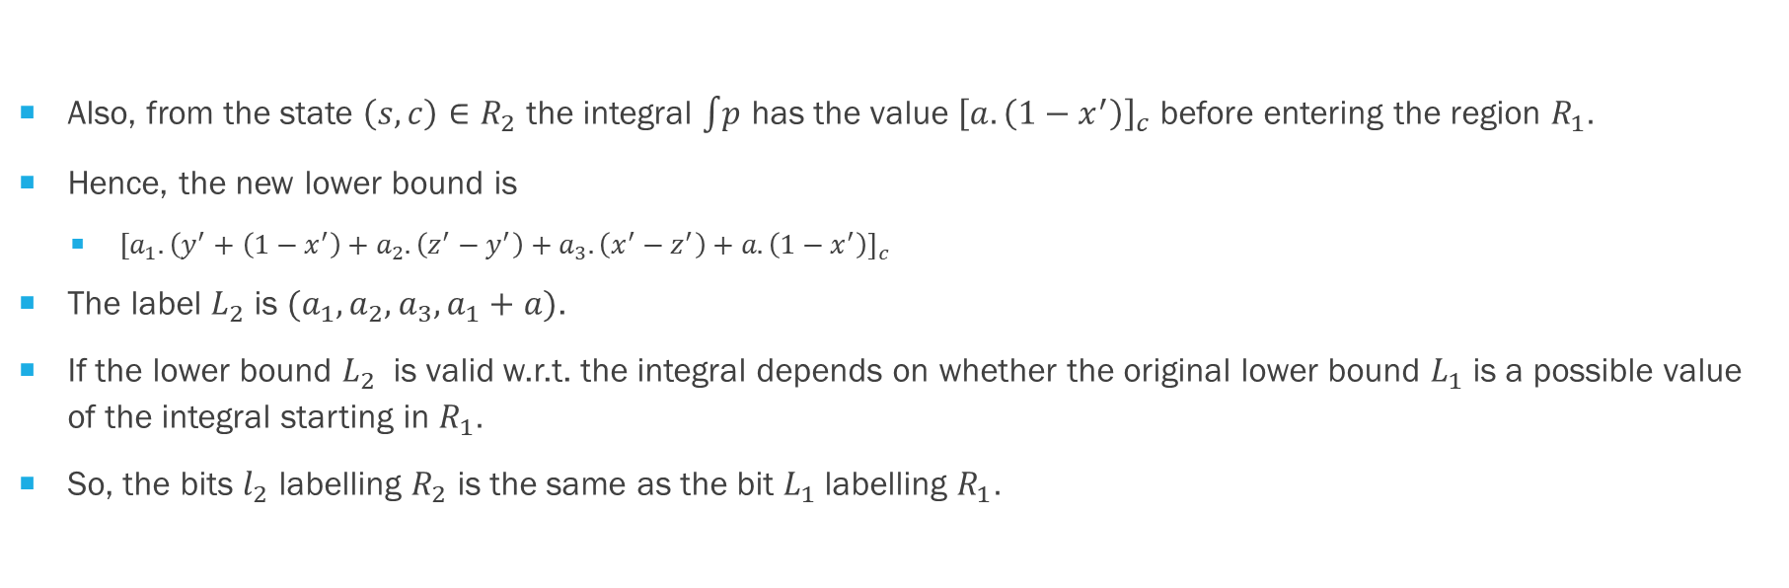
BOUND-labeled regions
Also, from the state $\left(s,c\right)∈R_{2}$ the integral $\int{p}$ has the value ${\left[a.\left(1−x^{′}\right)\right]}_{c}$ before entering the region $R_{1}.$
Hence, the new lower bound is
$[a_{1}.{\left(y^{′}+\left(1−x^{′}\right)+a_{2}.\left(z^{′}−y^{′}\right)+a_{3}.\left(x^{′}−z^{′}\right)+a.\left(1−x^{′}\right)\right]}_{c}$
The label $L_{2}$ is $(a_{1},a_{2},a_{3},a_{1}+a)$.
If the lower bound $L_{2}$ is valid w.r.t. the integral depends on whether the original lower bound $L_{1}$ is a possible value of the integral starting in $R_{1}.$
So, the bits $l_{2}$ labelling $R_{2}$ is the same as the bit $L_{1}$labelling $R_{1}.$

Slide 37
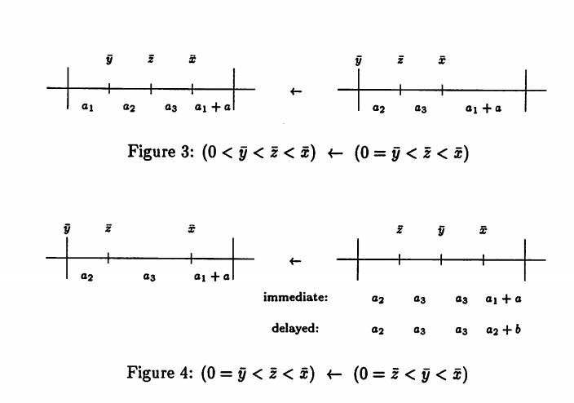
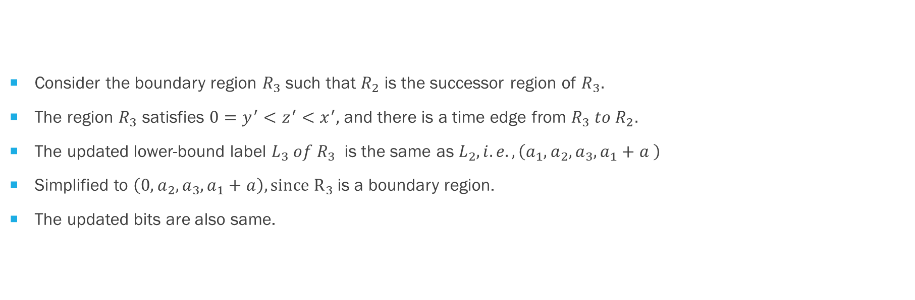
BOUND-labeled regions
Consider the boundary region $R_{3}$ such that $R_{2}$ is the successor region of $R_{3}.$
The region $R_{3}$ satisfies $0=y^{′}<z^{′}<x^{′},$ and there is a time edge from $R_{3} to R_{2}.$
The updated lower-bound label $L_{3} of R_{3}$ is the same as $L_{2}, i.e., \left(a_{1},a_{2},a_{3},a_{1}+a \right)$
Simplified to $\left(0,a_{2},a_{3},a_{1}+a\right), since R_{3}$is a boundary region.
The updated bits are also same.

Slide 38
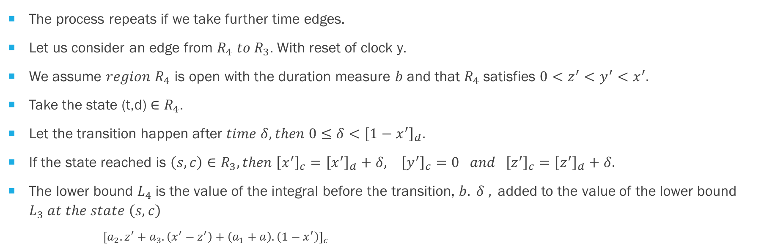
BOUND-labeled regions
The process repeats if we take further time edges.
Let us consider an edge from $R_{4} to{ R}_{3}.$ With reset of clock y.
We assume $region R_{4}$ is open with the duration measure $b$ and that $R_{4}$satisfies $0<z^{′}<y^{′}<x^{′}.$
Take the state (t,d) $∈R_{4}.$
Let the transition happen after $time δ, then 0≤δ<{\left[1−x^{′}\right]}_{d}.$
If the state reached is $\left(s,c\right)∈R_{3}, then {\left[x^{′}\right]}_{c}={\left[x^{′}\right]}_{d}+δ, {\left[y^{′}\right]}_{c}=0 and {{\left[z^{′}\right]}_{c}=\left[z^{′}\right]}_{d}+δ.$
The lower bound $L_{4}$is the value of the integral before the transition, $b. δ ,$added to the value of the lower bound $L_{3} at the state \left(s,c\right)$
${\left[a_{2}.z^{′}+a_{3}.\left(x^{′}−z^{′}\right)+\left(a_{1}+a\right).\left(1−x^{′}\right)\right]}_{c}$

Slide 39
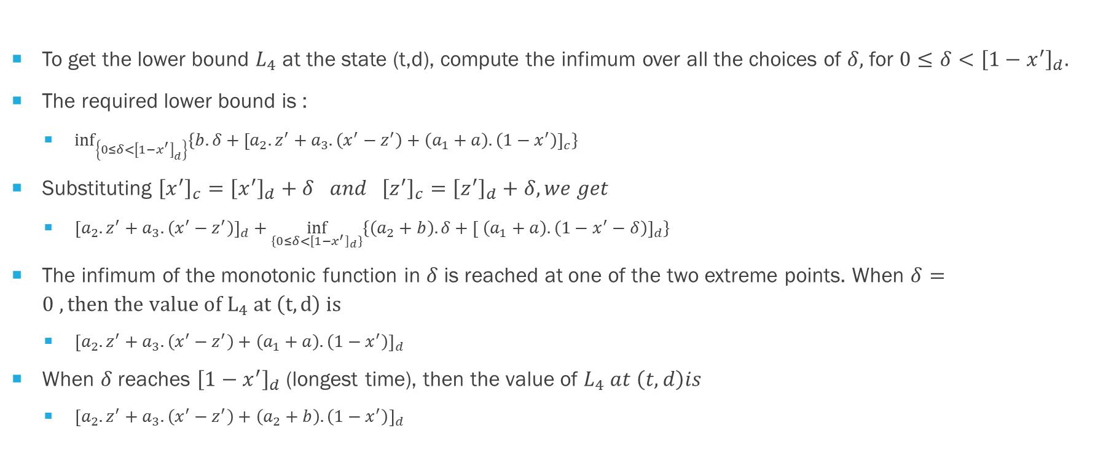
BOUND-labeled regions
To get the lower bound $L_{4}$ at the state (t,d), compute the infimum over all the choices of $δ,$for $0≤δ<{\left[1−x^{′}\right]}_{d}.$
The required lower bound is :
$\inf_{\left\{0≤δ<{\left[1−x^{′}\right]}_{d}\right\}}{\{b. δ+{\left[a_{2}.z^{′}+a_{3}.\left(x^{′}−z^{′}\right)+\left(a_{1}+a\right).\left(1−x^{′}\right)\right]}_{c}\}}$
Substituting ${\left[x^{′}\right]}_{c}={\left[x^{′}\right]}_{d}+δ and {\left[z^{′}\right]}_{c}={\left[z^{′}\right]}_{d}+δ, we get$
${\left[a_{2}.z^{′}+a_{3}.\left(x^{′}−z^{′}\right)\right]}_{d}+\inf_{\left\{0≤δ<{\left[1−x^{′}\right]}_{d}\right\}}{\{\left(a_{2}+b\right). δ+{\left[ \left(a_{1}+a\right).\left(1−x^{′}−δ\right)\right]}_{d}\}}$
The infimum of the monotonic function in $δ$ is reached at one of the two extreme points. When $δ=0 , then the value of L_{4} at \left(t,d\right) is$
${\left[a_{2}.z^{′}+a_{3}.\left(x^{′}−z^{′}\right)+\left(a_{1}+a\right).\left(1−x^{′}\right)\right]}_{d}$
When $δ$ reaches ${\left[1−x^{′}\right]}_{d}$ (longest time), then the value of $L_{4} at \left(t,d\right)is$
${\left[a_{2}.z^{′}+a_{3}.\left(x^{′}−z^{′}\right)+\left(a_{2}+b\right).\left(1−x^{′}\right)\right]}_{d}$

Slide 40
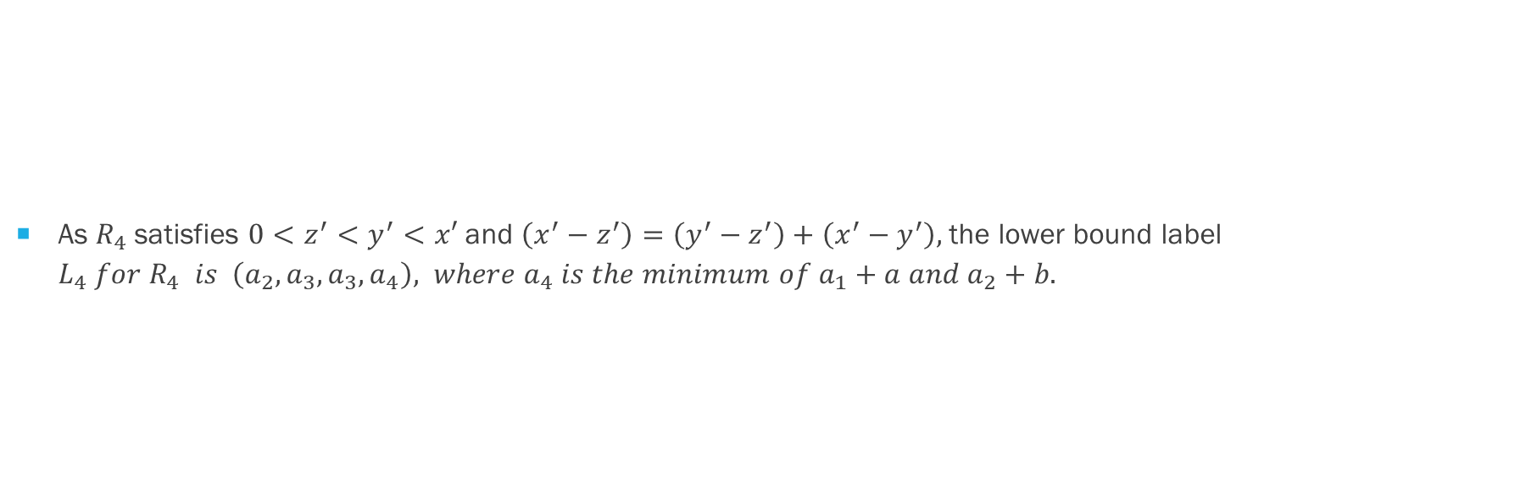
BOUND-labeled regions
As $R_{4}$satisfies $0<z^{′}<y^{′}<x′$ and $\left(x^{′}−z^{′}\right)=\left(y^{′}−z^{′}\right)+\left(x^{′}−y^{′}\right),$the lower bound label $L_{4} for R_{4} is \left(a_{2},a_{3},a_{3},a_{4}\right), where a_{4} is the minimum of a_{1}+a and a_{2}+b.$

Slide 41
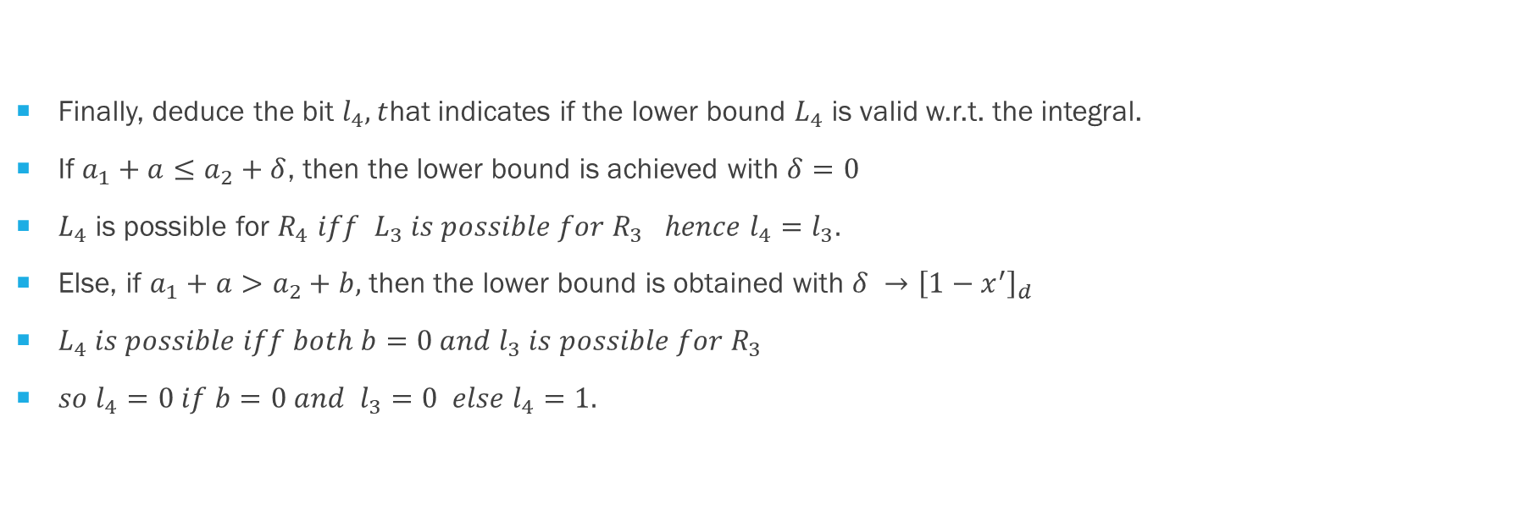
BOUND-labeled regions
Finally, deduce the bit $l_{4}, t$hat indicates if the lower bound $L_{4}$ is valid w.r.t. the integral.
If $a_{1}+a≤a_{2}+δ$, then the lower bound is achieved with $δ=0$
$L_{4}$ is possible for $R_{4} iff L_{3} is possible for R_{3} hence l_{4}=l_{3}.$
Else, if $a_{1}+a>a_{2}+b,$ then the lower bound is obtained with $δ →{\left[1−x^{′}\right]}_{d}$
$L_{4} is possible iff both b=0 and l_{3} is possible for R_{3}$
$so l_{4}=0 if b=0 and l_{3}=0 else l_{4}=1.$

Slide 42
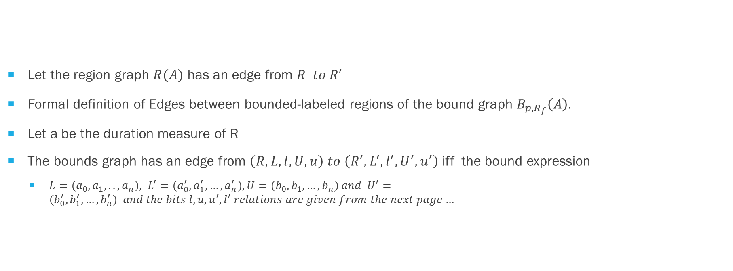
BOUND-labeled regions
Let the region graph $R(A)$ has an edge from $R to R^{′}$
Formal definition of Edges between bounded-labeled regions of the bound graph $B_{p,R_{f}}\left(A\right).$
Let a be the duration measure of R
The bounds graph has an edge from $\left(R,L,l,U,u\right) to \left(R^{′},L^{′},l^{′},U^{′},u^{′}\right)$iff the bound expression
$L=\left(a_{0},a_{1},..,a_{n}\right), L^{′}=\left(a_{0}^{′},a_{1}^{′},…,a_{n}^{′}\right), U=\left(b_{0},b_{1},…,b_{n}\right) and U^{′}=\left(b_{0}^{′},b_{1}^{′},…,b_{n}^{′}\right) and the bits l,u,u^{′},l^{′} relations are given from the next page…$

Slide 43
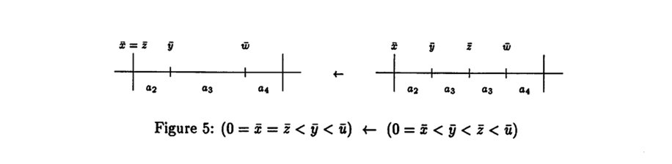
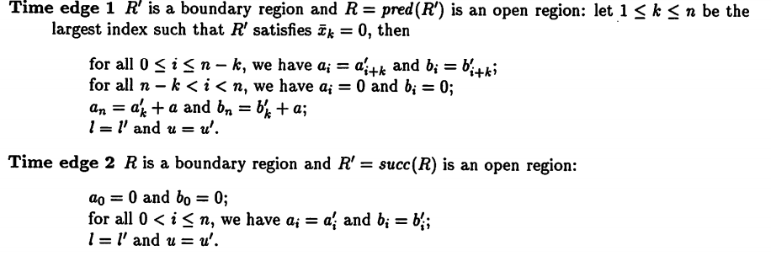
BOUND-labeled regions

Slide 44
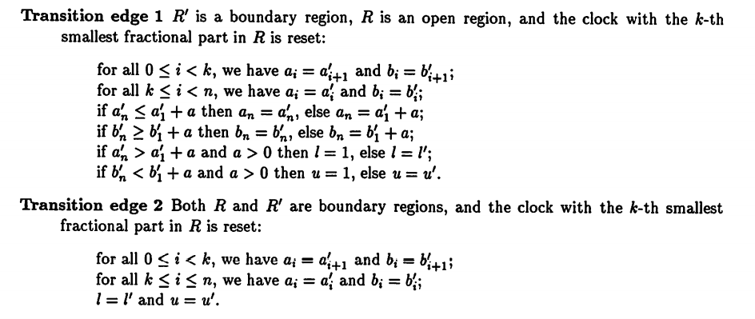
BOUND-labeled regions

Slide 45
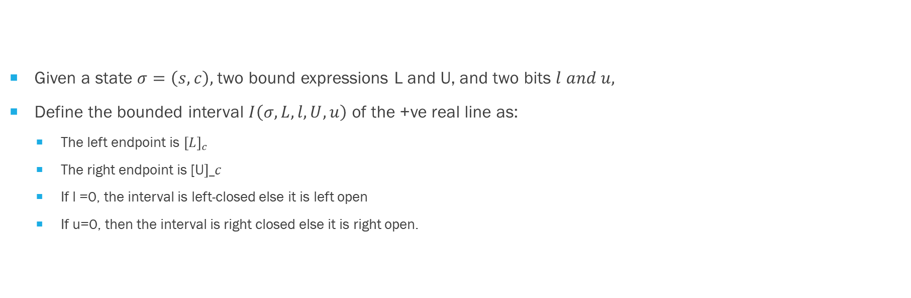
Reachability in the bounds graph
Given a state $σ=\left(s,c\right),$two bound expressions L and U, and two bits $l and u,$
Define the bounded interval $I\left(σ,L,l,U,u\right)$ of the +ve real line as:
The left endpoint is ${\left[L\right]}_{c}$
The right endpoint is [U$]_c$
If l =0, the interval is left-closed else it is left open
If u=0, then the interval is right closed else it is right open.

Slide 46
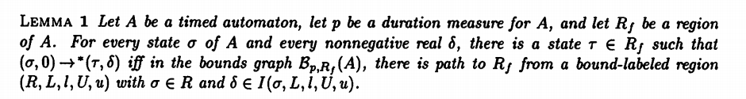
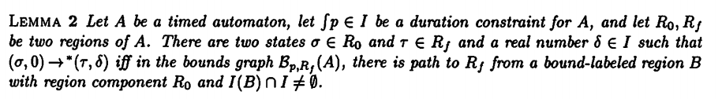
Reachability in the bounds graph regions

Slide 47
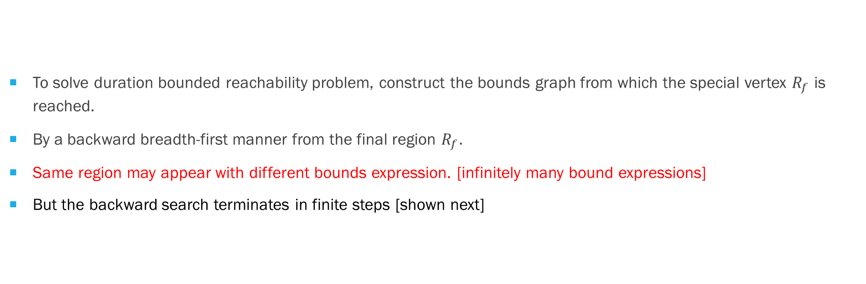
Reachability in the bounds graph regions
To solve duration bounded reachability problem, construct the bounds graph from which the special vertex $R_{f}$ is reached.
By a backward breadth-first manner from the final region $R_{f}.$
Same region may appear with different bounds expression. [infinitely many bound expressions]
But the backward search terminates in finite steps [shown next]

Slide 48
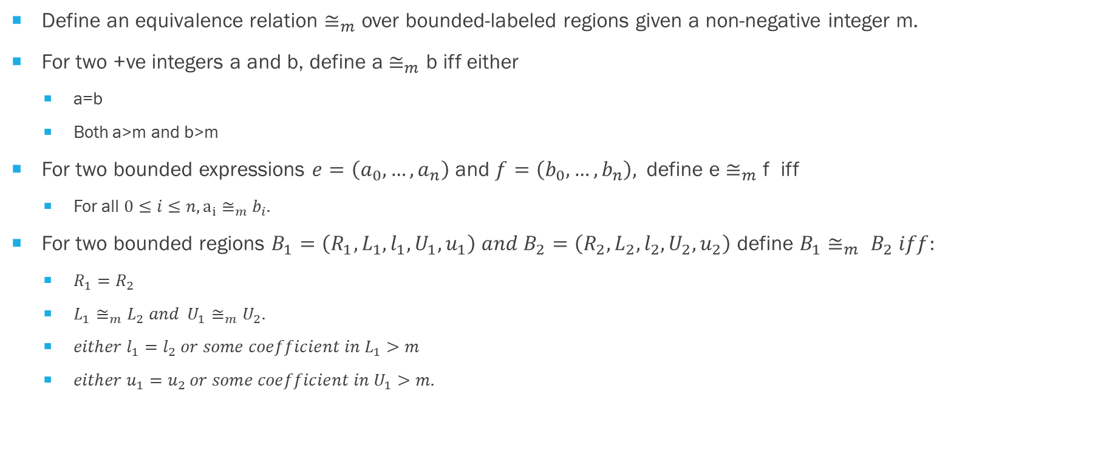
Collapsing the bounds graph
Define an equivalence relation $≅_{m}$ over bounded-labeled regions given a non-negative integer m.
For two +ve integers a and b, define a $≅_{m}$ b iff either
a=b
Both a>m and b>m
For two bounded expressions $e=\left(a_{0},…,a_{n}\right)$ and $f=\left(b_{0},…,b_{n}\right),$define e $≅_{m}$ f iff
For all $0≤i≤n, a_{i}$ $≅_{m}$ $b_{i}.$
For two bounded regions $B_{1}=\left(R_{1},L_{1},l_{1},U_{1},u_{1}\right) and B_{2}=\left(R_{2},L_{2},l_{2},U_{2},u_{2}\right)$ define $B_{1}≅_{m} B_{2} iff:$
$R_{1}=R_{2}$
$L_{1}≅_{m}L_{2} and U_{1}≅_{m}U_{2}.$
$either l_{1}=l_{2} or some coefficient in L_{1}>m$
$either u_{1}=u_{2} or some coefficient in U_{1}>m.$

Slide 49
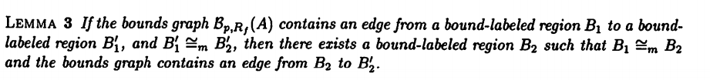
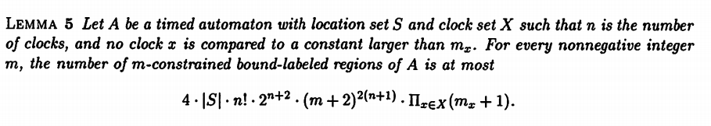

Slide 50
